Slide 1


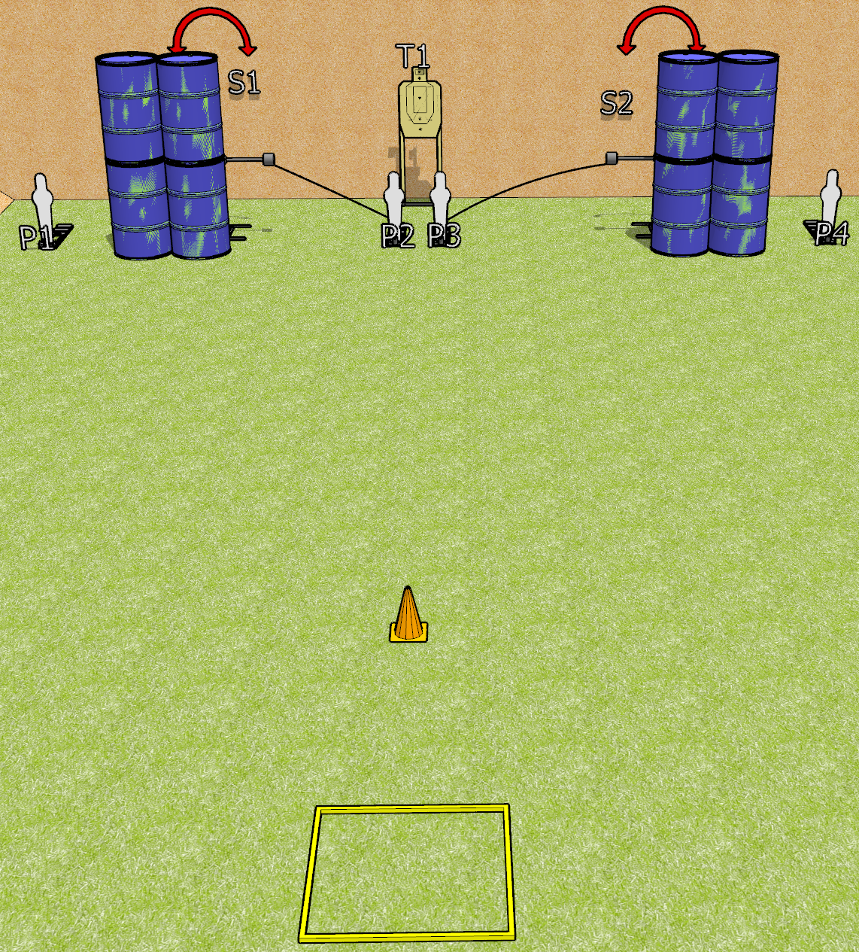
 | Dothan Gun Club – USPSA Match Speedy Course Designer : Drew Coleman
START POSITION : Standing in shooting box, wrists below belt
GUN READY CONDITION : Pistol loaded and holstered. PCC loaded, held with both hands, shouldered, safety on, pointed at orange cone. |  | SCORING: Comstock, 10 rounds TARGETS: 3 paper, 4 Steel SCORED HITS: Best 2 on paper, steel until down START-STOP: Audible, last shot RULES: Failure to perform a mandatory reload will incur a procedural per shot fired.
STAGE PROCEDURE: Engage P1-P4 OR T1, perform a mandatory reload, then engage the remaining array. S1 and S2 may be engaged at any time.

Slide 2
Speedy
Written Stage Briefing
Speedy is a 10 round, 50 point, Comstock speed shoot. There are three USPSA targets and four mini poppers. The best two hits on paper will score, and steel must fall to score.
P2 activates S1, and P3 activates S2. Please check all activators prior to walkthrough and set them same way for each shooter.
Handgun start position is standing in shooting box, wrists below belt. Handgun is loaded and holstered.
PCC start position is standing in shooting box, muzzle pointed at orange cone. Loaded carbine is held with both hands, shouldered, safety on.
On start signal, engage P1-P4 OR T1, perform a mandatory reload, then engage the remaining array. S1 and S2 may be engaged at any time.

Slide 3
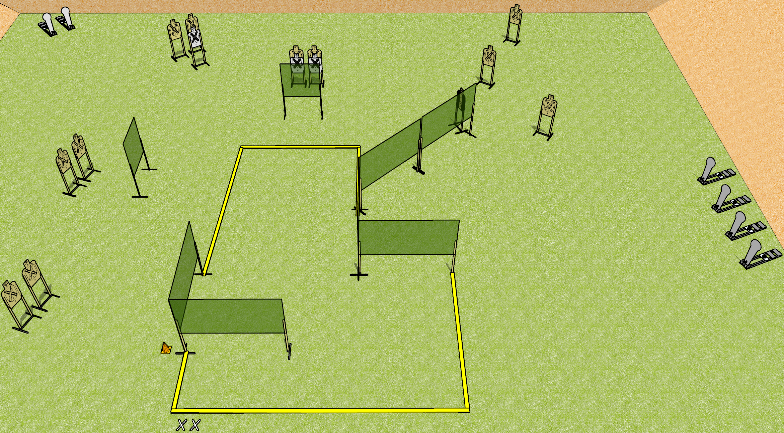
 | Dothan Gun Club – USPSA Match Something Clever Course Designer : Drew Coleman
START POSITION : Standing with both feet on X’s, wrists below belt
GUN READY CONDITION : Pistol loaded and holstered. PCC loaded, held with both hands, shouldered, safety on, pointed at orange cone. |  | SCORING: Comstock, 28 rounds TARGETS: 11 paper, 6 Steel SCORED HITS: Best 2 on paper, steel until down START-STOP: Audible, last shot RULES:
STAGE PROCEDURE: Engage targets as they become available from within the fault lines.

Slide 4
Something Clever
Written Stage Briefing
Something Clever is a 28 round, 140 point, Comstock field course. There are elevent USPSA targets and six Colt poppers. The best two hits on paper will score, and steel must fall to score. The start signal is audible.
Handgun start position is standing with both feet on X’s, wrists below belt. Handgun is loaded and holstered,
PCC start position is standing with both feet on X’s, muzzle pointed at orange cone. Loaded carbine is held with both hands, shouldered, safety on.
On start signal, engage targets as they become available from within the shooting area.

Slide 5
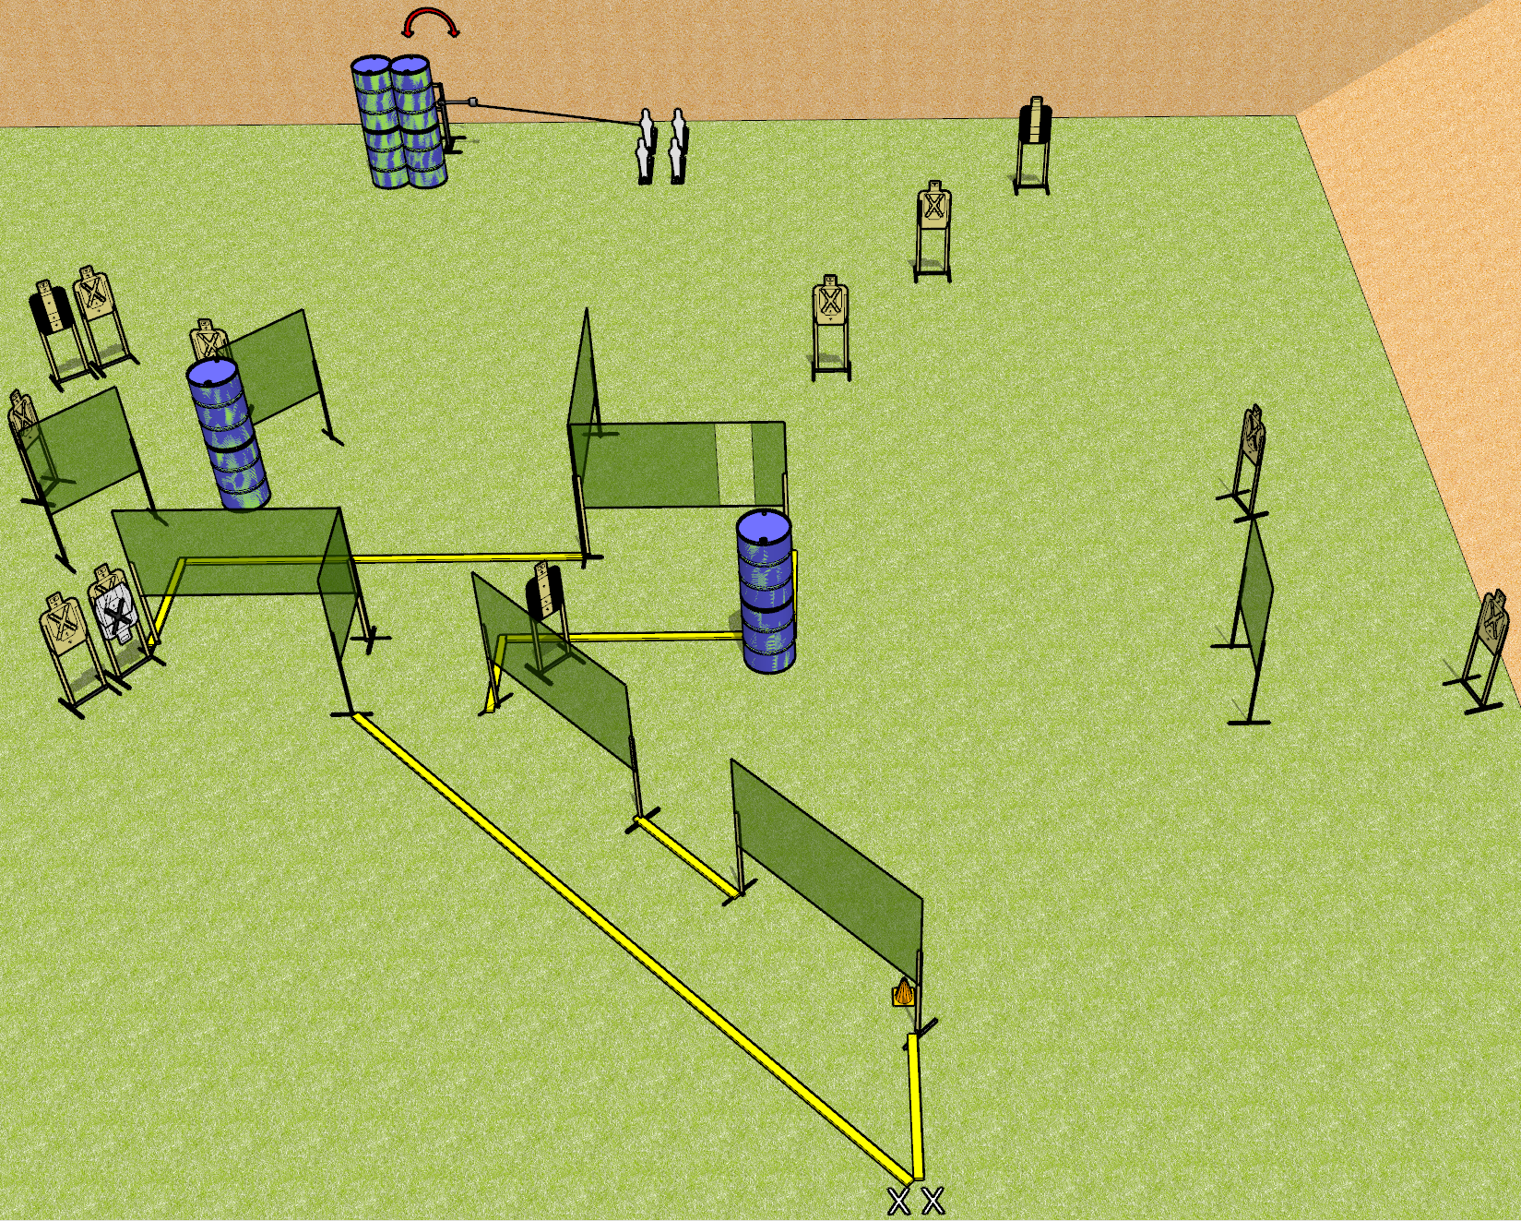
 | Dothan Gun Club – USPSA Match Underbite Course Designer : Drew Coleman
START POSITION : Standing with both feet on X’s, wrists below belt
GUN READY CONDITION : Pistol loaded and holstered. PCC loaded, held with both hands, shouldered, safety on, pointed at orange cone. |  | SCORING: Comstock, 30 rounds TARGETS: 13 paper, 4 Steel SCORED HITS: Best 2 on paper, steel until down START-STOP: Audible, last shot RULES:
STAGE PROCEDURE: Engage targets as they become available from within the fault lines.

Slide 6
Underbite
Written Stage Briefing
Underbite is a 30 round, 150 point, Comstock field course. There are thirteen USPSA targets and four mini poppers. The best two hits on paper will score, and steel must fall to score.
The back left mini popper activates the swinger. Please check the activator prior to walkthrough and set it the same way for each shooter.
Handgun start position is standing with both feet on X’s, wrists below belt. Handgun is loaded and holstered.
PCC start position is standing with both feet on X’s, muzzle pointed at orange cone. Loaded carbine is held with both hands, safety on, shouldered.
On start signal engage targets as they become available from within the shooting area.

Slide 7
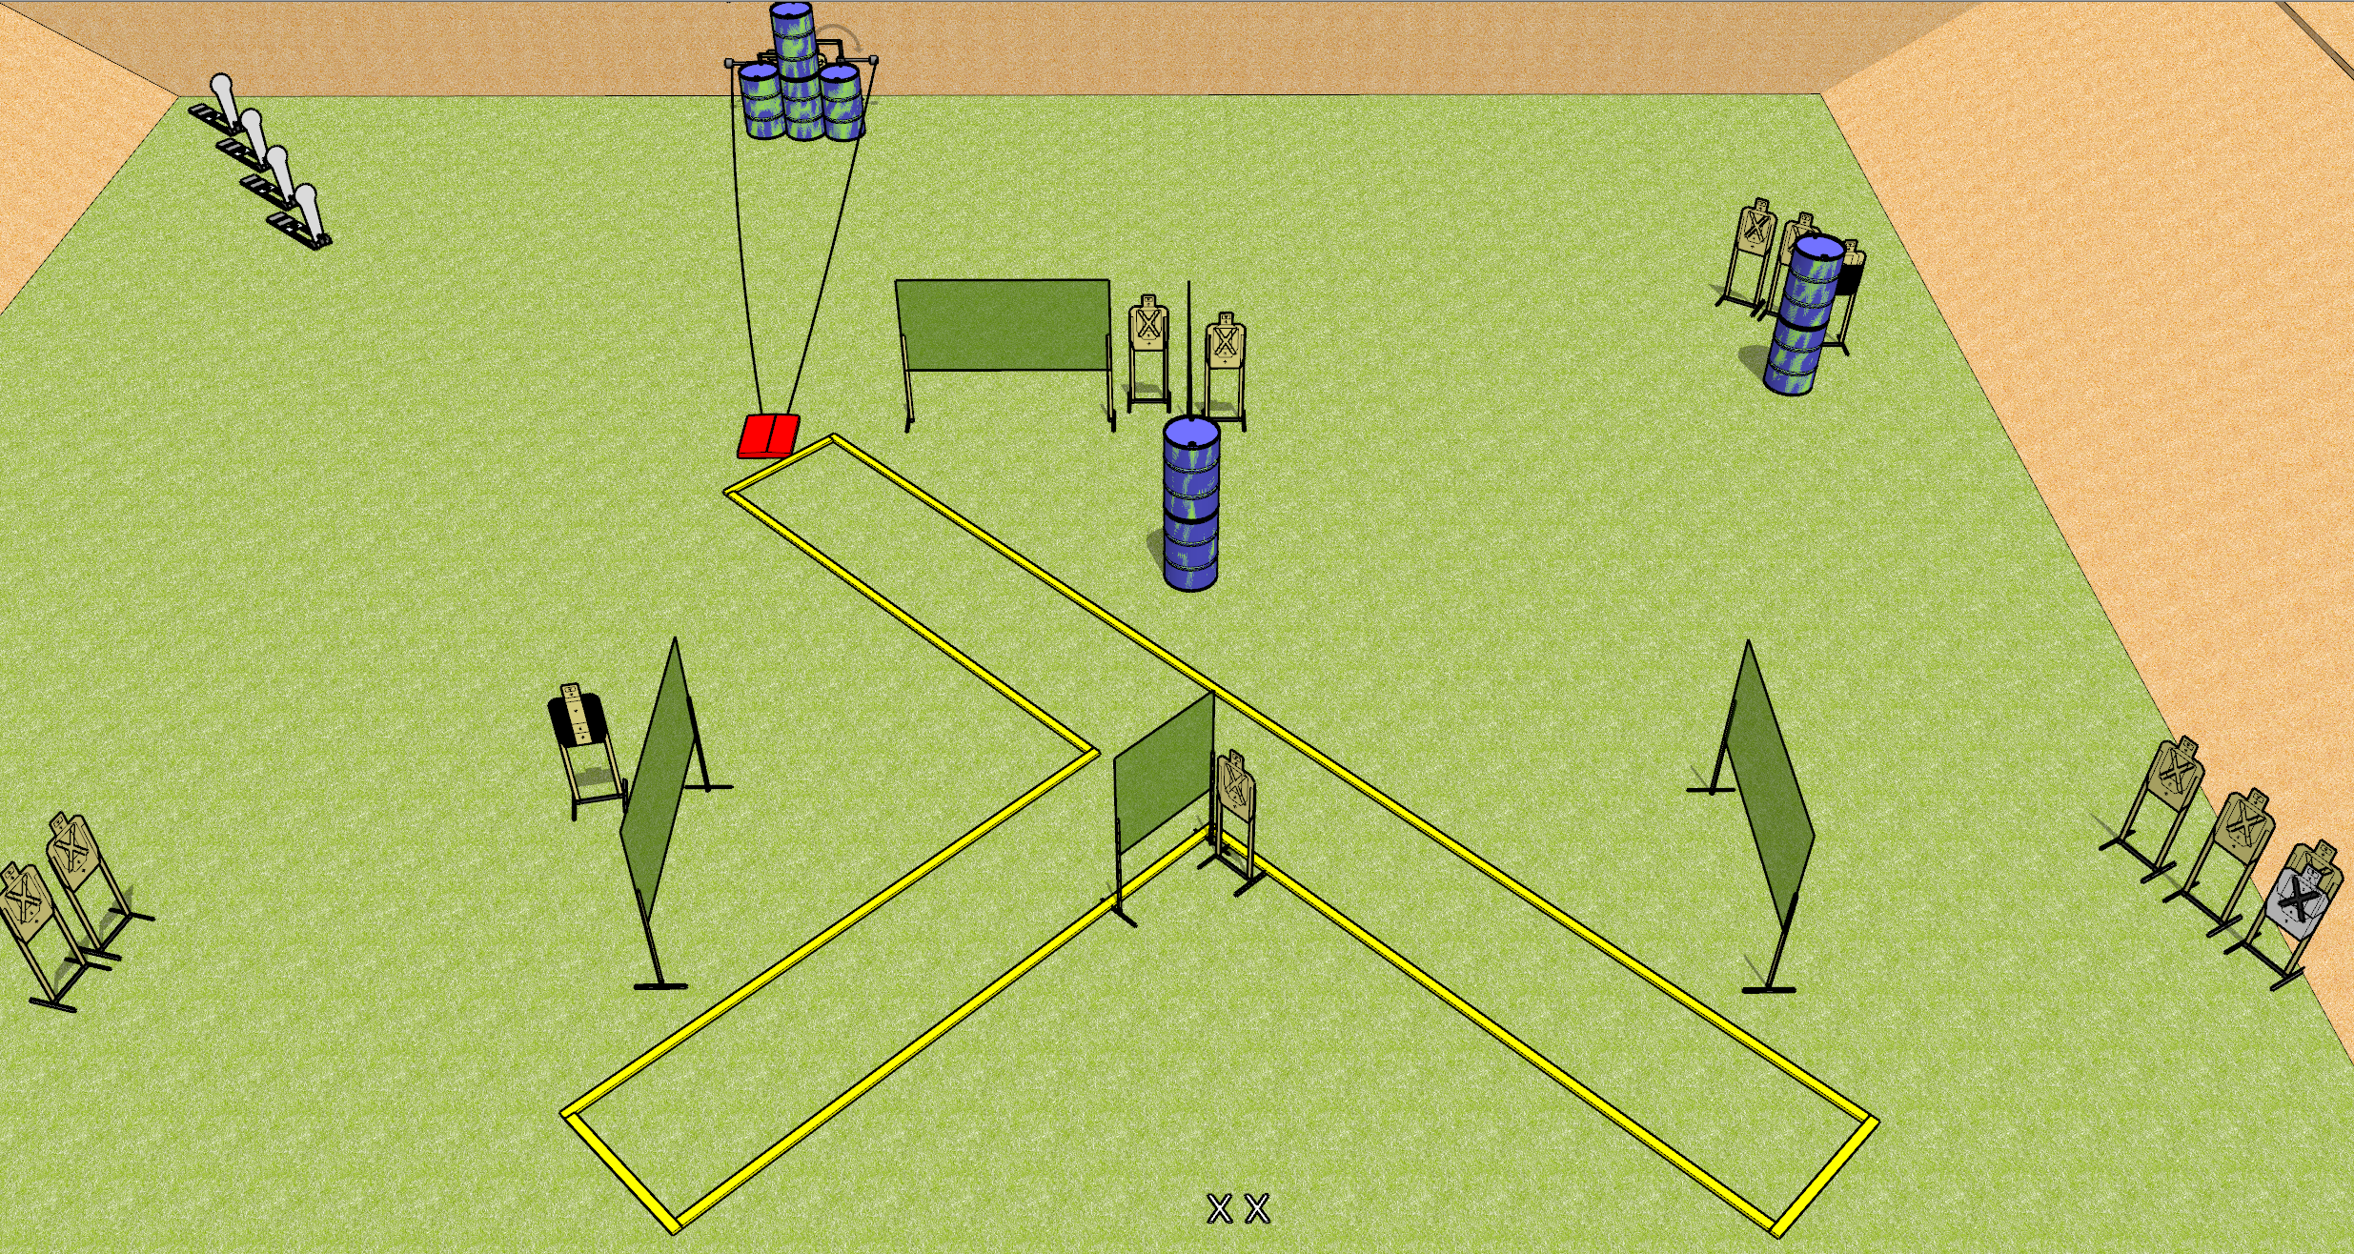
 | Dothan Gun Club – USPSA Match Y Course Designer : Drew Coleman
START POSITION : Standing with both feet on X’s, wrists below belt
GUN READY CONDITION : Pistol loaded and holstered. PCC loaded, held with both hands, shouldered, safety on. |  | SCORING: Comstock, 32 rounds TARGETS: 14 paper, 4 Steel SCORED HITS: Best 2 on paper, steel until down START-STOP: Audible, last shot RULES: Swinging targets must be activated before being engaged.
STAGE PROCEDURE: Engage targets as they become available from within the fault lines.

Slide 8
Y
Written Stage Briefing
Y is a 32 round, 160 point, Comstock field course. There are fourteen USPSA targets and four Colt poppers. The best two hits on paper will score, and steel must fall to score. The start signal is audible.
The stomp box activates the swinging targets. Swinging targets must be activated before being engaged. Please check the activators prior to walkthrough and set the same way for every shooter.
Handgun start position is standing with both feet on X’s, wrists below belt. Handgun is loaded and holstered.
PCC start position is standing with both feet on X’s. Loaded carbine is held with both hands, shouldered, safety on.
On start signal, engage targets as they become available from within the fault lines.

